Slide 1
Sales Data Analysis
By:
Neha Katla

Slide 2
Overview of Data
The attributes of data set - sales_data:
transaction id: a 6-digit integer to uniquely identify each transaction. A prefix of 'c' in the transaction id indicates a cancelled transaction.
product id: Unique identifier of the item sold.
product description: Name of the product being sold.
quantity sold: quantity of the item sold.
transaction timestamp: the time at which the transaction happened. This column can be used to join this table with the date.xlsx to obtain attributes of timestamp.
unit price: per piece price of the item sold.
customer id: Unique identifier of the customer who made the purchase.
transaction country: Country where the product was sold.
Date:
timestamp: self explanatory
date: self explanatory
day_name: self explanatory
day_of_month: self explanatory
month_of_year: self explanatory
time_of_day (hh:mm:ss): self explanatory

Slide 3
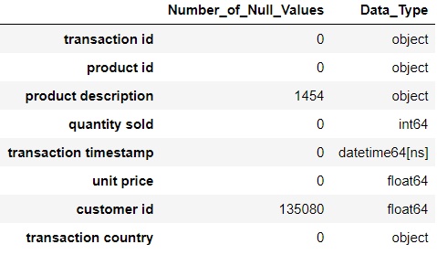
Overview of Data.
The sales_data data set consists of 5,41,909 entries and 8 columns.
Null values are present in product description column and customer id column.
The date data set consists of 5,41,909 entries and 6 columns. The date data set has no null values. Apart from these, I have added few more columns to the data set: Year, Month, Quarter of the Year,Is_Weekend and Total Price.

Slide 4
Data Cleaning
There were a lot of null values in customer id column. Removed null values in customer id column to avoid error in analysis.
Removed rows containing cancelled transactions and rows containing quantity sold less than or equal to zero because it must be an error in entering data and they do not contribute anything to the analysis.
Removed rows containing unit price value negative or zero.

Slide 5
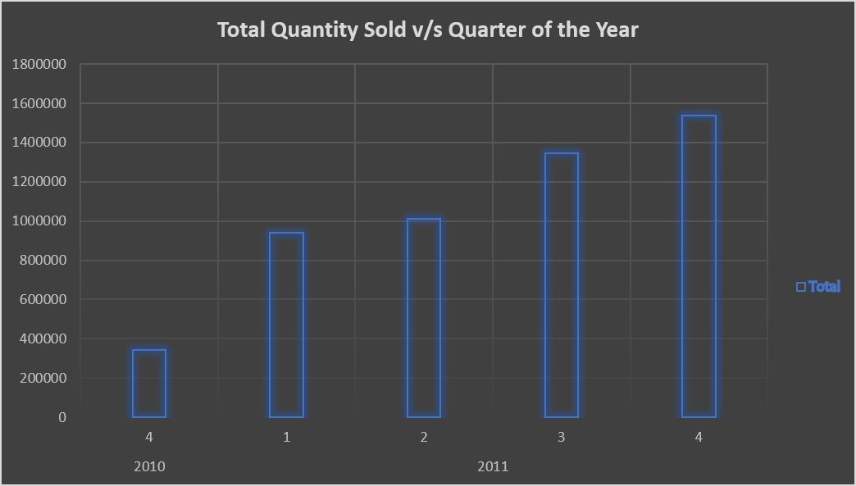
Sales Performance by Quarter of the year.
Sales Performance is seen improving in every quarter of the year. But let’s have a deeper look into the sales performance in every month of a year.

Slide 6
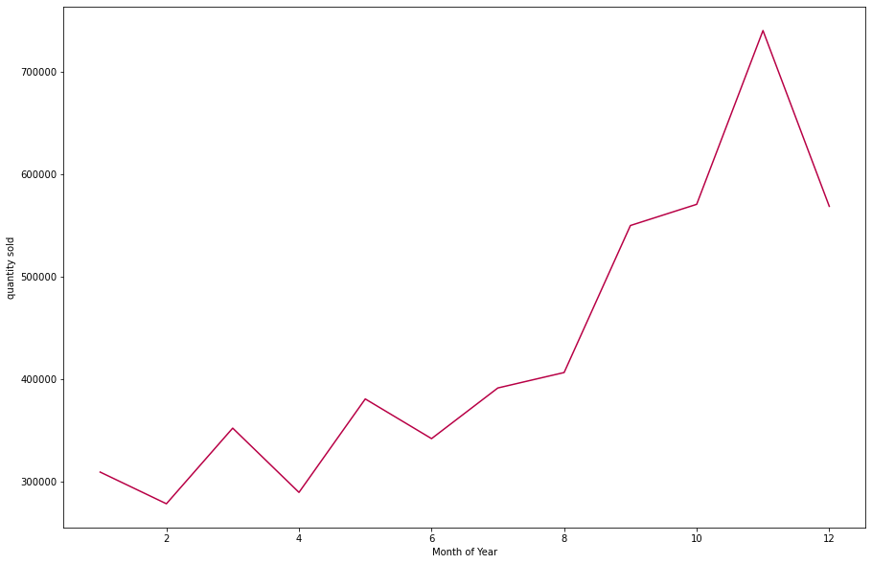
Is the company’s performance improving or degrading over time?
This graph is visualisation of
Quantity sold v/s Month of Year.
It can be observed from the plot that sales increase dramatically during the end of the year and fell low at the end.
Using monthly sales growth gives you actionable insights you can use to optimize your sales processes, strategies, and product priorities.

Slide 7
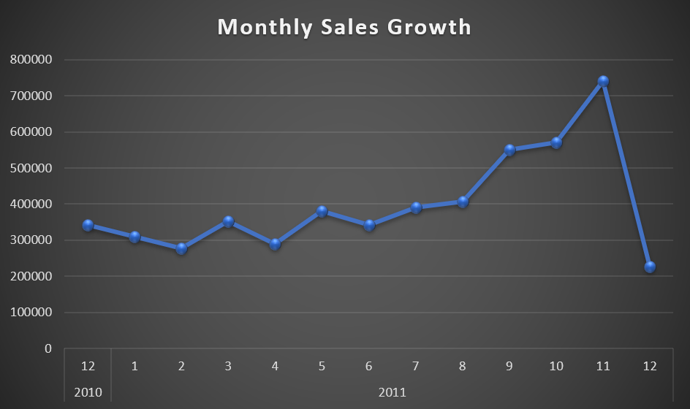
Is the company’s performance improving or degrading over time?
Monthly Sales Growth:
It can be observed that sales have increased from 2010 december to 2011 November but fell drastically in 2011 December.
This metric tells us how your sales revenue has grown/shrunk month-over-month. It’s an actionable metric that you can use to optimize your sales process and strategies.

Slide 8
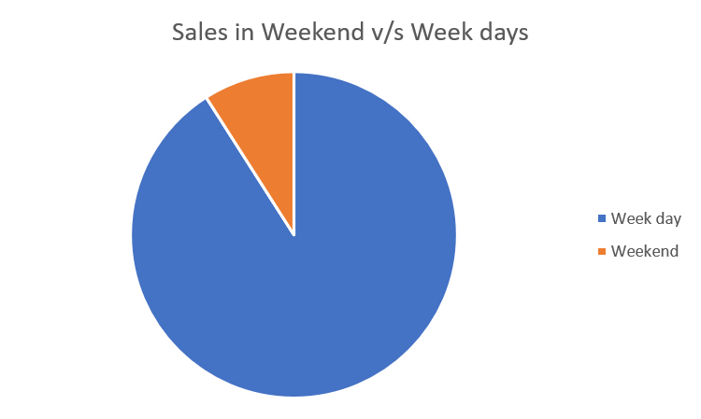
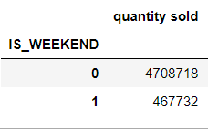
Important trends visible in the sales data and insights.
Sales Trends in a Week:
One would expect the sales to be more during the weekends. Contradictingly, the sales on the weekend are only 10 percent of the total sales in the weekdays. Saturday and Sunday are taken as weekends and the remaining days are taken as week days.

Slide 9
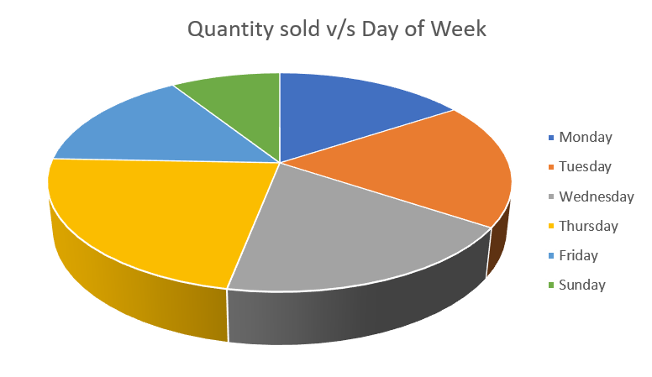
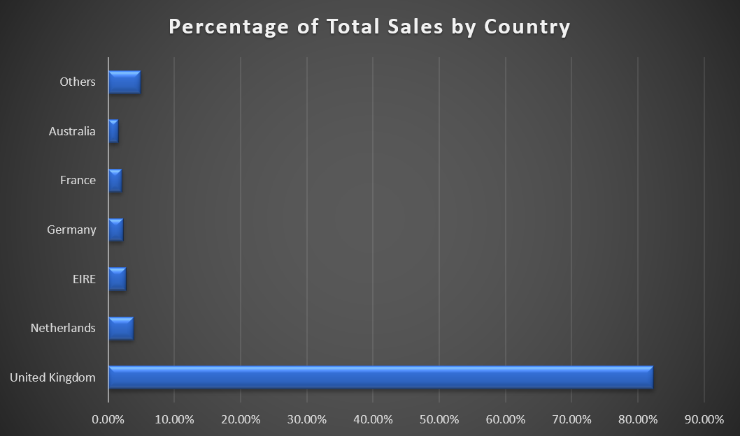
Important trends visible in the sales data and insights.
Observations:
1. The top 6 countries in sales account to 95% of our total sales.
2. Sales are highest in the mid-week(Wednesday, Thursday) and least on Sunday.

Slide 10
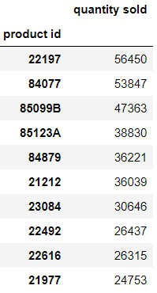
Important trends visible in the sales data and insights.
Top 10 products sold:
Sales and customer base are the highest in United Kingdom worth $8,187,806. The country having lowest sales is Saudi Arabia worth $1311.
There are no sales on Saturday. So, saturday must be a holiday for the company.
It is important to know in which country our company performs better because if we increase the production in that country, our company’s performance will increase.
It lets you approach product sales data from various angles like the demographics, product popularity, and the like. Multi-product firms like ours can use the results from this analysis to take constructive actions, like discontinuing unprofitable products.

Slide 11
Performance in terms of customer acquisition and building customer loyalty
Why is it important? : Customer Loyalty means choosing our company’s products and services consistently over our competitors. If our customers are loyal, they aren’t easily swayed by price or availability of products of our competitors. Customer acquisition is an expensive task, increasing customer acquisition shows a significant increase in profit. So, it is important to understand what caused your customers to leave. How is it done? : To evaluate the company’s performance in terms of customer acquisition, I added a column to calculate how many times a customer has visited the company till that timestamp from the beginning.
So, from this data it will be easy to derive the company’s performance in acquiring new customers every month or in that case every quarter or year. But since we only have data of one year(2011) and only december month in 2010. We cannot measure our performance in terms of customer acquisition by year. So, I have plotted no. of new customers we acquire per month. Please refer to the next slide.

Slide 12
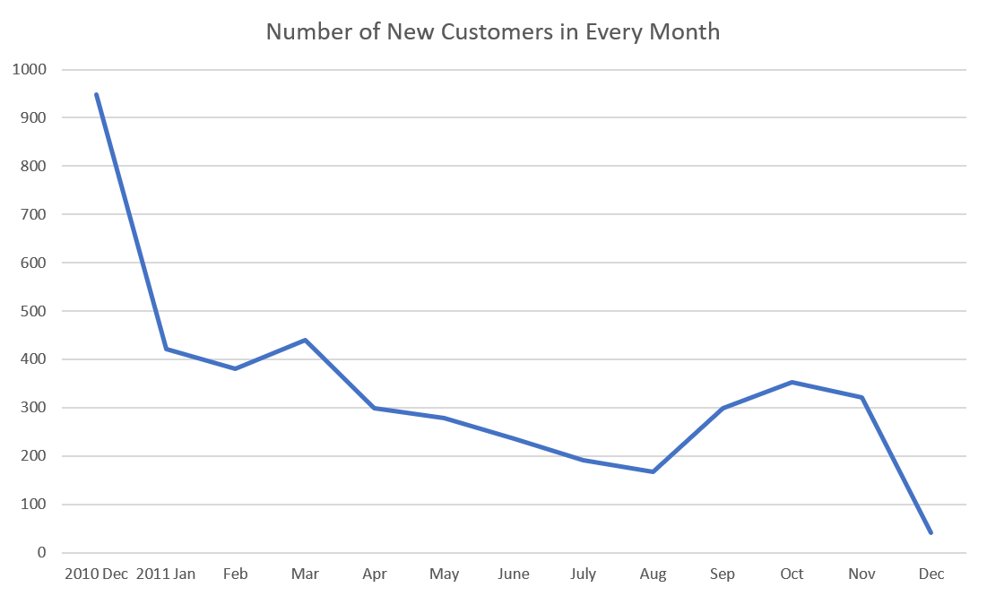
Performance in terms of Customer Acquisition:
The number of new customers have decreased since the company has been opened in 2010.
So, in terms of customer acquisition, we can say that the company’s performance has not been satisfactory.

Slide 13
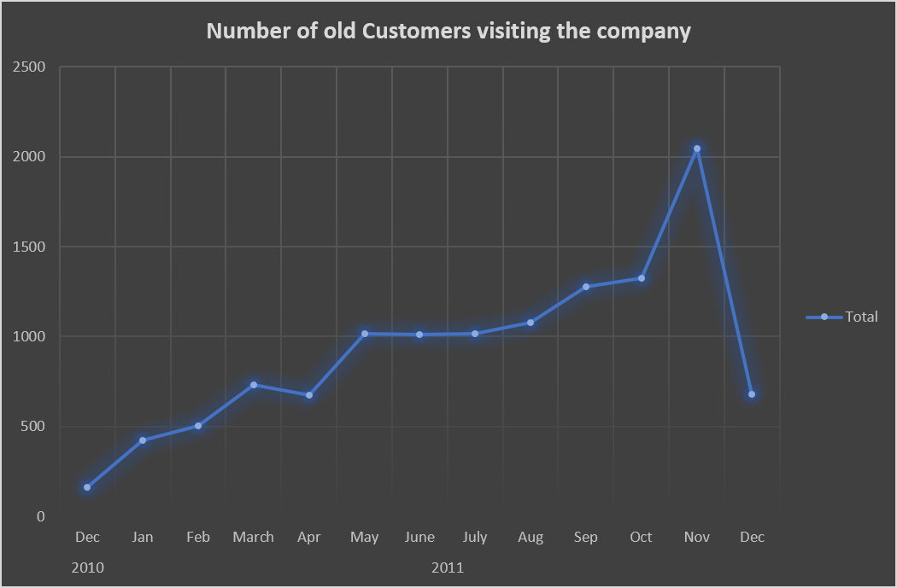
Performance in terms of customer acquisition and building customer loyalty
Approximately 70% of the customers who have bought our products, buy from us again.
This is a plot of Number of old Customers visiting the company every month. From the plot it is clear that the numbers are increasing, except for the case in december in which regardless of anything, sales were less.
So, from the data it is clear that the company is doing well in terms of customer loyalty.

Slide 14
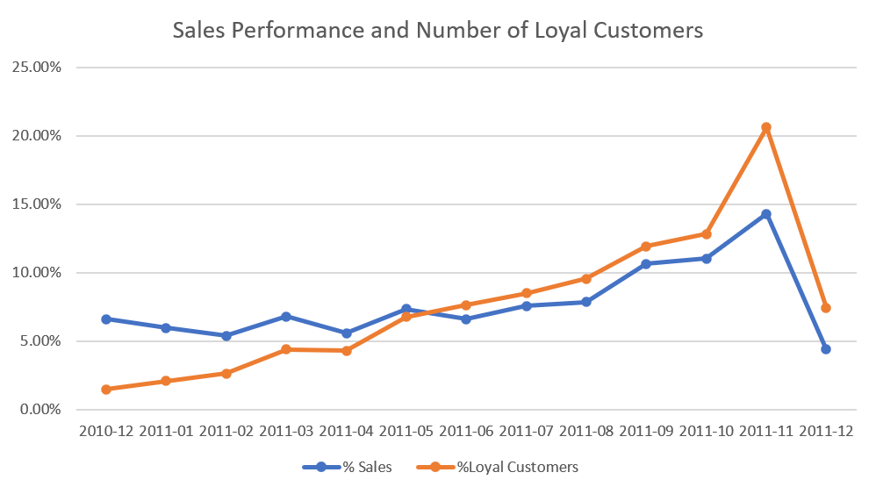
Relationships and drivers of sales that might be hidden in the dataset.
A plot of Percentage of Total Number of Sales and Percentage of Total Loyal Customers in Every month shows us the hidden directly proportional relationship between the both attributes.
From this plot, it is clear that no. of loyal customers have direct effect on the sales performance.

Slide 15
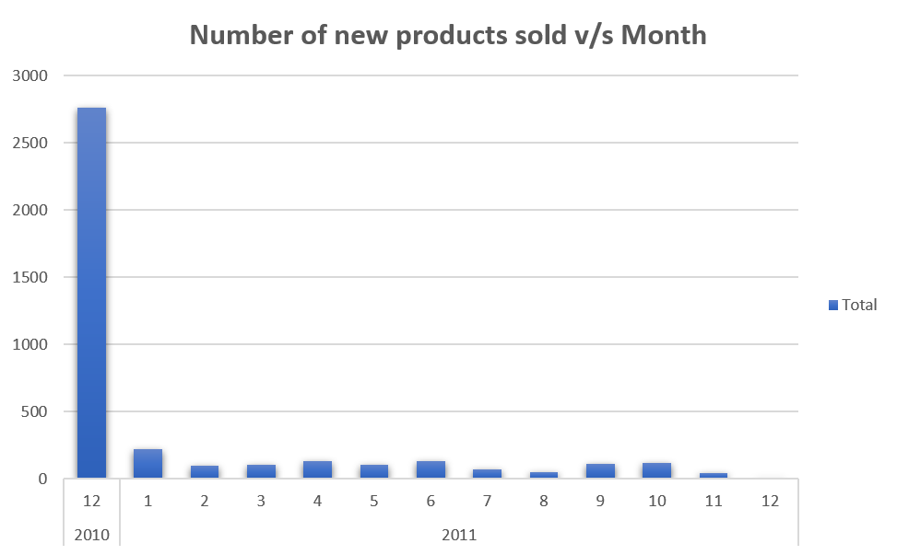
Relationships and drivers of sales that might be hidden in the dataset.
The company is not updating and making new products according to the needs of customer. This will have a negative impact on business if our competitors understand their needs better and sell upgraded products.

Slide 16
Can we take some initiatives based on the data to increase the sales? Based on data can we avoid out of stock situations?
We can increase the sales by doing the following: 1. Increase Customer base. 2. Decrease the unit price by decreasing the packaging cost, service cost etc in countries with low GDP. 3. Make better service experience, better packaging etc in rich countries. Because an average person in the capitalist, industrialized, first world countries will not be intimidated by the price but he/she will visit our company again if the service provided is better.
To avoid out of stock situations: 1. From the data, on an average, the sales increase by 10- 20% every quarter. 2. So, we can calculate how much stock we will need for the next quarter and make sure to avoid out of stock situations.

